Slide 1
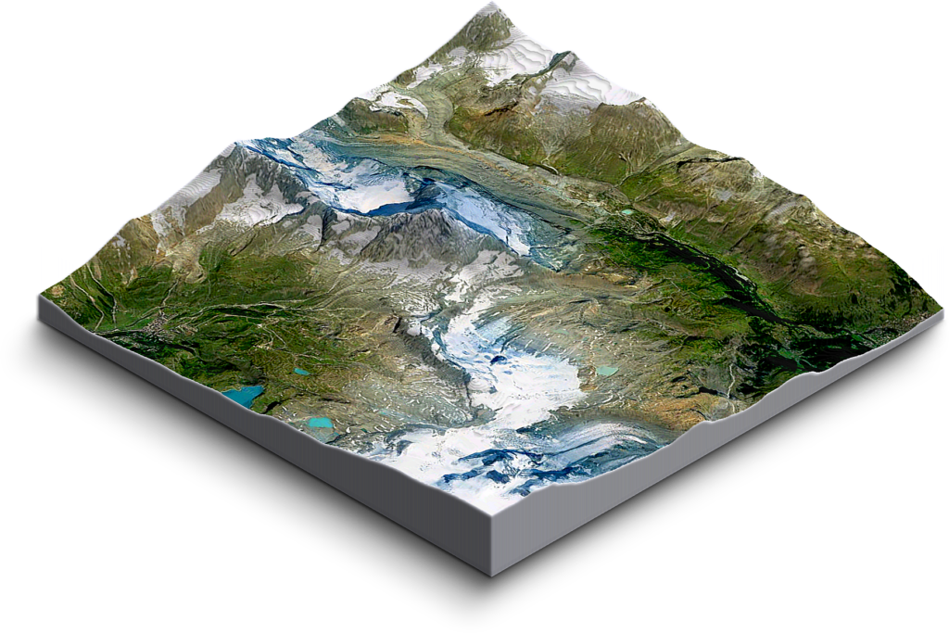
Infinite and Procedural Terrain Generation: A Post-Mortem
Student Name: James Mullineux
Supervisor Name: Dr Sud Sudirman
Student ID: 794796

Slide 2
In this presentation…
Introduction
What was the project aim and why?
What were the project objectives?
Did I complete my objectives, did I achieve the project aim?
Project showcase video
What went well?
What didn’t go well?
How would I improve the project?
A final reflection
Questions
Notes:
In this presentation, I will give a quick introduction; explain what my aims for this project where and a justification for why. I’ll discuss whether I accomplished my goals, what went well, what didn’t go well, mention how Covid-19 affected the project, how I would improve my project and give a final reflection on my experience. I will also take questions at the end.

Slide 3
Introduction
An Introduction…
My name is James Mullineux
I’m a Computer Games Development student
I was supervised by Dr Sud Sudirman
Notes:
Hi, my name is James Mullineux. I’m a Computer Games Development student and this is a post-mortem of my final software project; which was supervised by Dr Sud Sudirman.

Slide 4

My Project Aim and Objectives
Formulating Ideas
My final project:
It had to be ambitious and challenging
It had to be interesting and relevant
I wanted to gain important new experience
I wanted a good portfolio peice
Notes:
For this project, I had some requirements, it had to be; challenging, interesting, help me gain new experience and be useful for my portfolio and future job prospects. I met all those requirements. By pursuing a development area that was new to me, I have proved to myself and future employers that I am a great independent learner; an excellent skill to have as a games developer. My project was also very interesting, it explored areas of game development that are used by even the biggest games companies. I also gained new experience by using the Unity engine and C# language; this will be extremely useful when I enter the games industry.
To come up with my project idea, I took some time to think of gameplay mechanics that I thought were interesting and could be a good project topic. My favourite games are large in scale, and also very replay-able; so procedural terrain generation seemed like the perfect combination of both. I had no understanding of procedural terrain generation so I conducted some preliminary research and proposed the idea to a lecturer. He liked the sound of it and referred me to my supervisor, Dr Sud Sudirman, as he was very knowledgeable in this area. After discussing the idea with him I decided on a final project aim… [Next Slide]

Slide 5

My Project Aim and Objectives
The Project Aim
A whole new development area:
Procedural Terrain Generation
Infinite Terrain System
Report my research and observations
A whole new engine and language:
Unity Game Engine
C# Programming Language
Notes:
The Project Aim:
The aim of the project was to use a Perlin noise algorithm to procedurally generate a 3D terrain mesh. The user would be able to change different variables and parameters to procedurally generate different 3D meshes. Furthermore, I wanted to implement an endless terrain system; allowing the user to move a viewer to generate an infinitely large 3D world.
A whole new development area:
At the point I started the project, terrain generation was very much a grey area for me. I had very little experience beyond using the built-in terrain tools in Unreal Engine, and even then my experiences with those tools were limited. For procedural terrain generation, I had absolutely no idea. However, once I did some preliminary research and gathered the opinions of my supervisor and other lecturers, I knew this was the perfect topic to pursue; it was interesting, challenging and full of potential.
For my final project, I wanted to develop 2D and 3D terrain that was generated procedurally from Perlin Noise; as further goals I wanted to make the terrain generate infinitely as the viewer moves around. My report would describe the development process, including my research and observations.
A whole new engine:
The engine I decided to use to develop my final product is Unity, a leading engine in the games industry; but one that was new to me as I had primarily used Unreal throughout my years at university. The engine uses the C# programming language, a language I had not personally used as Unreal uses the C++ language. Both these factors would provide an interesting additional challenge to the project.

Slide 6
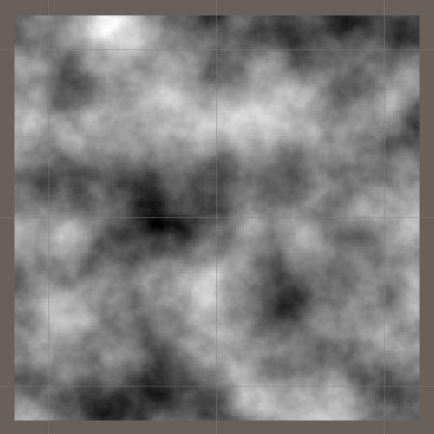
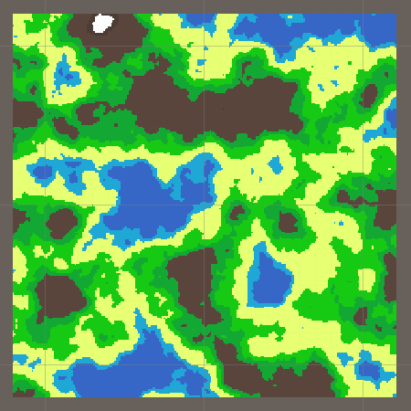
My Project Aim and Objectives
The Project Objectives
Perlin noise algorithm, height map
and colour map:
Generate Perlin noise map
Render Perlin noise map
Complex noise parameters
User controlled parameters
Generate and render height map and colour map
User controlled regions (assigning colours)
Notes:
Project Objectives:
To better understand how to achieve the project aim, I used my research to break the problem down into a number of objectives. I would know that the aim had been achieved once each and every objective had been completed.
Perlin Noise Map and Colour Map:
First, I would have to use a Perlin noise algorithm to generate a noise map; the project would also have to be able to render the noise map as a 2D texture to the screen. Once this was complete, more complex parameters would be implemented (e.g. octaves, persistence, lacunarity, offset, seed, etc.) that the user could control in order to control and generate new noise maps.
Using the generated noise map, a height map would be generated so that a colour map could be generated and rendered to the screen as a 2D texture. The colour map is used as a 2D representation of terrain. Additionally, the user would be able to assign colours to different height ranges; this is the regions system.

Slide 7
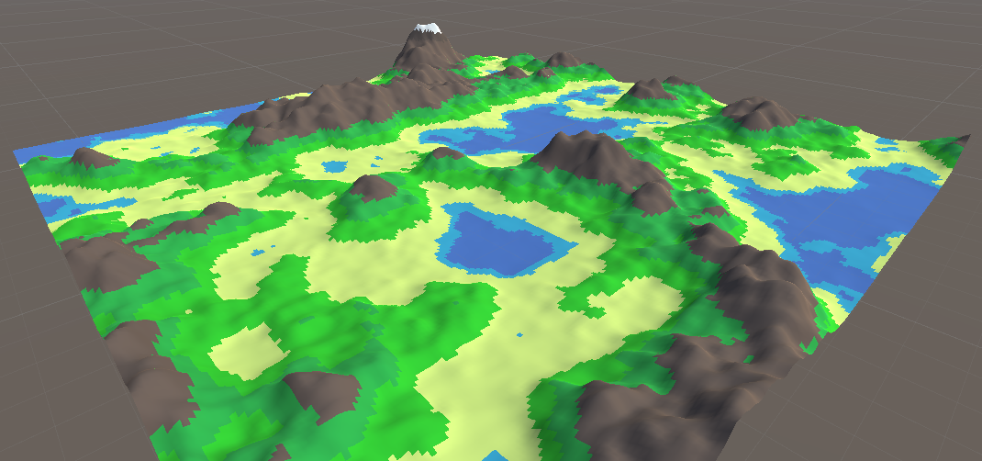
My Project Aim and Objectives
The Project Objectives
3D Terrain Mesh:
Generate 3D Terrain
Height curve
Level of Detail (LOD)
Textured mesh
Falloff map
Notes:
3D Terrain Mesh:
Using the noise map and height map as the foundation, the project would be able to generate a 3D terrain mesh to resemble a landscape. A height curve would also be implemented to allow the user to control how much different height ranges are affected by the height multiplier (the multiplier used to scale the mesh).
Additionally, a LOD system would be implemented to allow the user to control how detailed the mesh is; a less detailed mesh would render with less vertices and triangles, whilst a more detailed mesh would render with more vertices and triangles. This LOD system would be used within the infinite terrain system to improve system performance. The mesh would also be textured based on the colours/regions set by the user on the colour map.
An extra feature, not part of my original design was also implemented, this allows the user to use a falloff map to surround terrain entirely with water; creating an island.

Slide 8
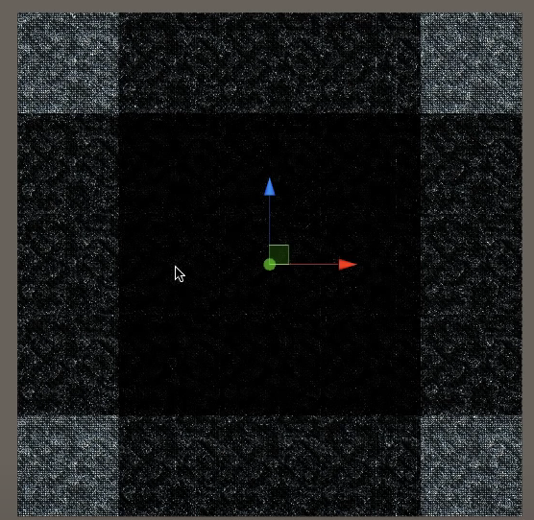
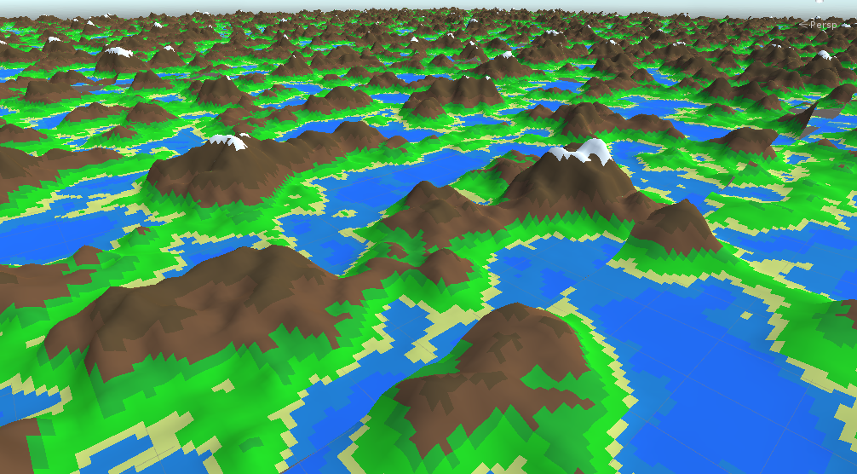
My Project Aim and Objectives
The Project Objectives
Infinite Terrain System:
Chunks and viewer
Threading
Level of Detail (LOD)
Seams
Notes:
Infinite Terrain System:
Now that a 3D terrain mesh can be rendered, the next step would be to implement the infinite terrain system; allowing the user to move a viewer object that could explore an infinitely large terrain.
Terrain Chunks and Viewer:
The main technique that would be used to implement an endless terrain system would be chunks. This technique uses a viewer (or a player character) and generates chunks of terrain that are within visible distance of the viewer. As the viewer moves, chunks that are now in visible range will be rendered and chunks that are now outside the visible range would no longer be rendered. Using this technique means that the viewer/player can move throughout the world and generate an infinite amount of terrain. This chunks technique is the same technique that Minecraft uses.
Threading and LOD:
Threading and LOD are two different techniques that are used to improve a systems performance when rendering terrain. The LOD system would be integrated into the infinite terrain system so that terrain chunks that are furthest from the viewer/player are rendered with less vertices and triangles, whilst chunks closer to the viewer are rendered with more vertices and triangles. This way, the performance of the system is improved significantly with a minimal impact on the players immersion.
Seams:
Now that an infinite number of chunks could be rendered, the seams between the chunks would have to be fixed. Chunks that are rendered would have to have their offsets aligned and their outmost vertices joined so that the illusion of a single continuous mesh is created.

Slide 9


My Project Aim and Objectives
The Project Objectives
Notes:
Unity and C#:
Finally, the project had to be developed entirely using Unity and C#. I had never used this engine and language before when I started the project; this meant that I would have to take time to learn the Unity development environment as well as become comfortable with C# syntax. This was an important objective for me to complete however, Unity and C# are tools used massively in the games industry and being comfortable with their use was crucial.

Slide 10
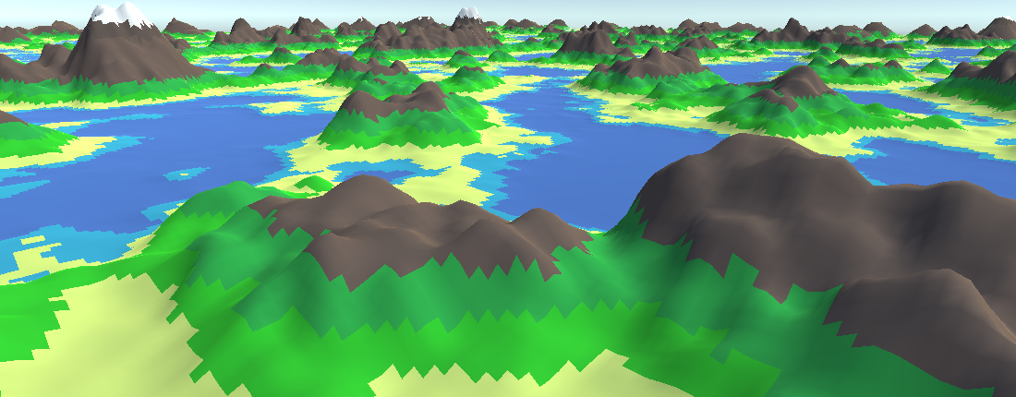

My Project Aim and Objectives
Project Aim Achieved?
Notes:
My project was an astounding success, my final software product was ambitious and fulfils all my requirements and I have a well structured report to boot. All of my initial objectives were completed and this meant that the project aim had been achieved. My breaking down my project aim into objectives, and assigning tasks with deadlines to complete those objectives, I was able to complete my project with time to spare.

Slide 11
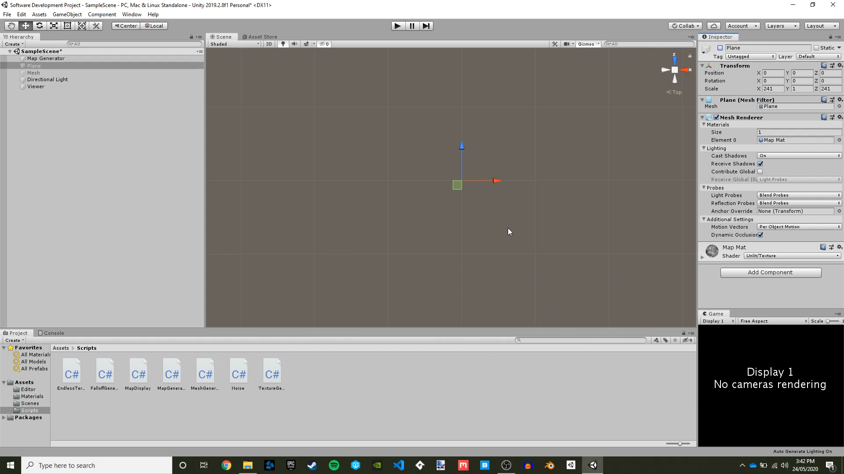
Project Showcase
Notes:
Here is a video recording of my software product, showcasing its features. [Pause the video at points to further explain features]

Slide 12
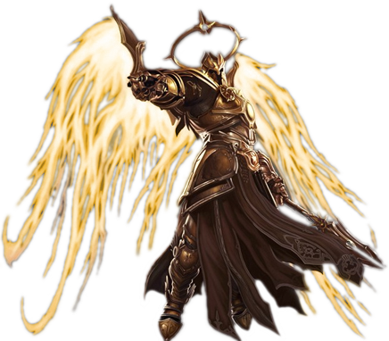
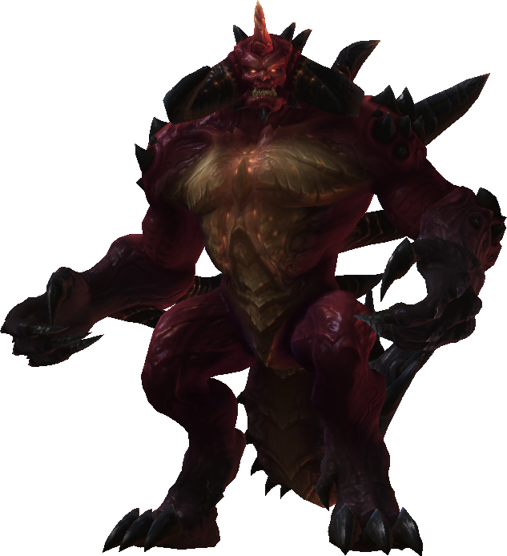
Project Reflection
The Good…
Strong and plentiful research
Quick learner (Unreal to Unity)
Quick learner (C++ to C#)
Timekeeping and Milestones
Fast product progress
The Bad…
Slower report progress
Notes:
So, what went well for my project?
Strong and plentiful research:
My project made extensive use of both offline and online research materials; my preliminary literature review showed that research in this area was plentiful, but I also had to rely on my own ability to turn this research into a tangable final product, which I was able to do well.
Quick learner:
I was initially nervous that I had bitten off more than I could chew by using a new games engine and programming language, however, I found that my experiences with Unreal and C++ greatly helped me make the jump to Unity and C#. The programming environments and techniques are fairly similar and I found myself surprised at how quickly I adapted. By forcing myself to develop the project with these tools, I have greatly increased my employability as these tools are used widely in the games development industry.
Timekeeping and Milestones:
My project management was perhaps the best it has ever been for this project. I made sure to lay out a plan for the whole year and assigned myself milestones to achieve; I made an early start on this project, beginning almost immediately, and this proved to be a great decision. Along with this, I attended every monthly meeting/check-up with my supervisor to lay out what I had done the previous month, get feedback and lay out my specific tasks for the next month. I took an agile development approach to this project, iterating on and improving the project regularly, and it worked perfectly. It all meant I made quick progress on my software product.
Fast Product Progress:
Excellent project management and an early start meant that I was able to complete my software product comfortably; with time to spare to shore up my report and polish/comment my code.
---------------------------------------------------------------------------------------------------------------------------------------------------------------------------------------------------------------------------------------------------------------------------------
What went not so well? Well, not a lot as it turns out.
Slower report progress:
It could be said that progress on my report was slower when compared to my software product, however, I was still able to finish the report in time for the initial deadline and any delayed progress was often the result of me focusing on work for other modules.

Slide 13


Project Reflection
How would I Improve?
Product improvements:
Implement erosion tools
Player and gameplay mechanics
Additional meshes
Report improvements:
More regular updates
Notes:
Product improvements:
There are a number of ways my final product can be expanded upon and improved. Firstly, implemented erosion tools so that the landscape can be manually altered by the developer; however, this is a big undertaking and would require another project similar to this for that alone. Since I am a games development student, a natural progression would be to add a player and add gameplay mechanics; essentially make use of the generated terrain in a game. I could also make the terrain more aesthetically pleasing by adding additional meshes, foliage, clouds, wildlife, sounds, etc.

Slide 14
Final Reflection
Final Reflection…
Project aim achieved!
Pushed myself and was ambitious!
New engine and programming language learnt!
Greater understanding of noise algorithms, 3D terrain techniques, infinite terrain implementation and procedural generation!
Independent learner!
Good project management!
Notes:
I am very happy with the outcome of my project. I have learnt a lot about how terrain is generated, how to generate terrain procedurally and how infinite terrain is effectively implemented. Additionally, I can comfortably say that I can now develop projects using Unity and C# which will help me greatly in the future. My project aim was achieved, all of the objectives were complete and I was even able to expand the project beyond the initial design by implementing a falloff map. Overall, it was a stressful but fun and productive venture.

Slide 15

Questions?
Notes:
I will now answer any questions.

